Slide 1


Present Status of Biometric Time Attendance System (Face Detection/Fingerprint) Devices & Customized web based Realtime Attendance Software for DHAKA WASA
Date: 15/03/2022
Time: 12: 30 PM

Slide 2
Beginning of Biometric Attendance
July 2018 We started our journey at Dhaka WASA with our revolutionary biometric digital time attendance terminal series ZKTeco F18
Started with only 5 device at Dhaka WASA head office (WASA Bhaban)
2 Nos. Device at SWTP-1&2.

Slide 3

Key information before COVID/19 Pandemic
Total Bio-Metric (Fingerprint) Device Installed :
48 Nos. (Including WASA Bhaban)
Total Registration Complete :
2906 out of 2921 ( 99.5% )
*** Due to finger problem 15 persons not completed.
Total Finger Problem : 75 Persons.
Total Damage Machine: 02 Nos.
Total Location: 32 Nos.

Slide 4
During lockdown
Government of Bangladesh declared lockdown from 26/03/2020
March 2020 pandemic COVID-19 speared rapidly and our government take decision immediately for lockdown to all over the country. That’s why WASA all office stopped taking biometric attendance due to lockdown and so that the virus can’t speared.
Total 07 (Seven) months stopped.

Slide 5
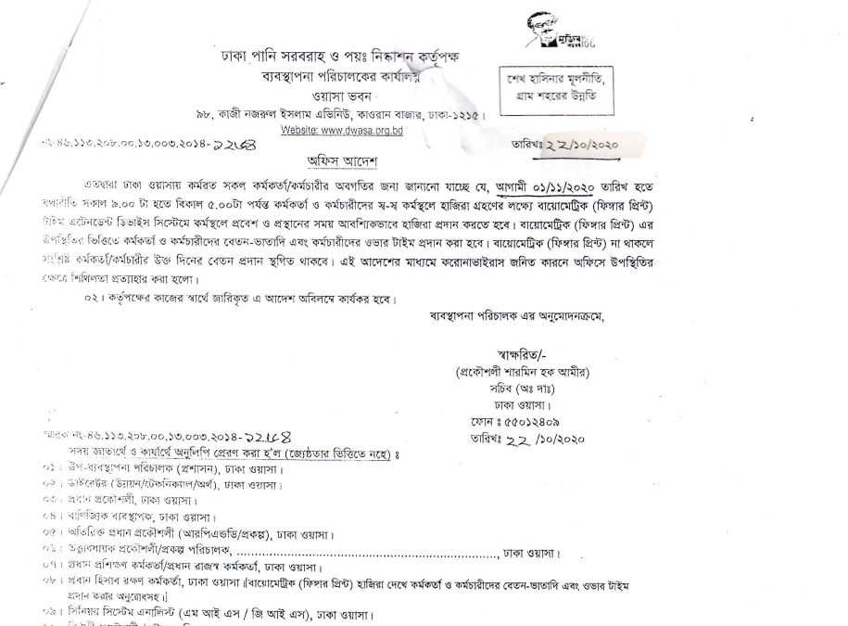
Restart

Slide 6
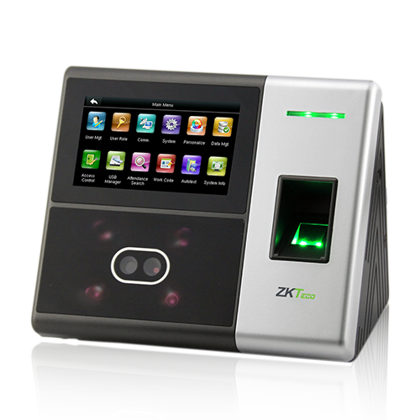
New Face detection Time attendance system
WASA authority took decision to replace biometric fingerprint attendance system with new technology 3D face detection attendance devices to avoid contagious contamination from finger touch
UFace800+
ZKTeco's newly released UFace800+ Semi-Outdoor Multi-Biometric Time Attendance & Access Control Terminal which supports 3,000 face templates, 4,000 fingerprint templates and 10,000 cards.

Slide 7
New era of Face detection Time attendance system
2nd June 2020 we installed 02 Nos. face detection device at SWTP-1&2
Replicate face detection attendance system at WASA Bhaban as well as different MODS zone, revenue zone, WTP etc. location.

Slide 8
Present Statistics
Sl No. | Office/Division/Zone Name | Finger Print Device Quantity | Face Detection Device Quantity
1 | WASA Bhaban Kawran Bazar | 03 Pcs. | 02 Pcs
2 | MODS Zone-01&7, Revenue Zone-01&07 Jatrabari | 01 Pcs. | 01 Pcs
3 | MODS Zone-02 & Revenue Zone-02 Chandighat, Lalbag | 01 Pcs. | 01 Pcs.
4 | MODS Zone-03, Revenue Zone-03 & Training Centre, Lalmatia, Mohammadpur | 02 Pcs. | 01 Pcs.
5 | MODS Zone-04 & Revenue Zone-04 Near Bangla College, Mirpur-01 | 01 Pcs. | 01 Pcs.
6 | MODS Zone-05, Revenue Zone-05 & Revenue Zone-08, TB Gate , Mohakhali | 01 Pcs. | 01 Pcs.
7 | MODS Zone-06 & Revenue Zone-06, Fokirapool | 01 Pcs. | 01 Pcs.

Slide 9
Present Statistics
Sl No. | Office/Division/Zone Name | Finger Print Device Quantity | Face Detection Device Quantity | Access Control
8 | MODS Zone-08 Notun Bazar, Baridhara | - | 01 Pcs.
9 | MODS Zone-09, Uttara. | - | 01 Pcs.
10 | Revenue Zone-09, Uttara | - | 01 Pcs.
11 | MODS Zone-10 Near BRTA,Mirpur-10 | - | 01 Pcs. | SCADA Room-01 No
12 | Revenue Zone-10 Near BRTA,Mirpur-10 | - | 01 Pcs.
13 | SWTP-1 Dholpur, Saydabad | - | 01 Pcs. | Lab Room - 01 No.
14 | SWTP-2 Dholpur, Saydabad | - | 01 Pcs.

Slide 10
Present Statistics
Sl No. | Office/Division/Zone Name | Finger Print Device Quantity | Face Detection Device Quantity | Access Control
15 | FMD-1, Tikatuli | - | 01 Pcs.
16 | FMD-2 Near Bangla College, Mirpur-1 | - | 01 Pcs.
17 | Generator Division Segunbagicha | - | 01 Pcs.
18 | Narayanganj MODS Khanpur, Narayanganj | 01 Pcs. | -
19 | Narayanganj Revenue Khanpur, Narayanganj | 01 Pcs. | -
20 | Meter Division Segunbagicha, Dhaka | 01 Pcs. | -
21 | Lalbag Water Works Lalbag, Dhaka | - | 01 Pcs.

Slide 11
Present Statistics
Sl No. | Office/Division/Zone Name | Finger Print Device Quantity | Face Detection Device Quantity | Access Control
22 | Godnail Water Works Godnail, Narayanganj | 01 Pcs. | -
23 | Bottle Water Production Plant (BWPP) Mirpur-10 | - | 01 Pcs. | Lab. – 01 Pcs.
24 | Microbiology & Chemical Division Asadgate, Mohammadpur | - | 01 Pcs.
25 | SOC Division Eskaton | - | 01 Pcs.
26 | PSTP Syampur,Pagla | - | 01 Pcs.
27 | Store Division Syampur,Pagla | - | 01 Pcs.
28 | Vakurta IRP-1 DWFP, SKWFP | - | 01 Pcs.

Slide 12
Present Statistics
Sl No. | Office/Division/Zone Name | Finger Print Device Quantity | Face Detection Device Quantity | Access Control
29 | Vakurta IRP-2 DWFP, SKWFP | 01 Pcs. | -
30 | PJWTP | - | 01 Pcs. | SCADA Room – 02 Pcs. Server Room – 01 Pcs. Lab Room – 01 Pcs.
31 | IPS (PJWTP) | 01 Pcs. | -
32 | BOOSTER PS (PJWTP) Keraniganj, Dhaka | 01 Pcs. | -
33 | MODS Zone-5 (Water Pump/SLS) | - | *16 Pcs.
 | Total | 17 Pcs | (26+16)=42 Pcs. | 07 Pcs.

Slide 13
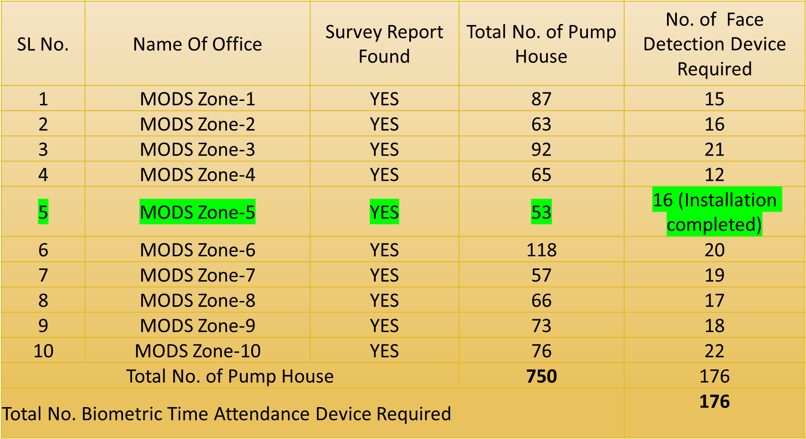
Water Pump/SLS House Survey Report (1 Km Distance)

Slide 14
Customized Web based Realtime Attendance Software for DHAKA WASA

Slide 15
Connected Device in Different location WASA offices
Present Piloting Status of Device Connection:
WASA Bhaban : 2 Nos Device
MODS Zone-3 & Revenue Zone-3: 1 Nos. Device
SWTP-1: 1 Nos. Device
SWTP-2: 1 Nos. Device
Total Device Connected: 05 Nos.

Slide 16
FEATURES
Dashboard for Management. (Currently available.)
Scheduled Reporting to Management by E-Mail. (Currently available.)
Online access of Staff & user. (Currently available.)
Android & iOS Application. (On Demand)
SMS alert (On Demand)

Slide 17
Current Piloting link
http://wasa.itechbd.net/login/

Slide 18
Centralized customized
Software feature
USER MANAGEMENT
  User administration
  Multi user Role access with different privileges.
  Role Based Access Control
  Role Based Input Control
STAFF ATTENDANCE
  Staff Attendance Entry.
  Customized Reporting of Section Wise & Individual Staff Attendance.
  Daily Absent & Absconding SMS Notification to Staff
  Customized Reporting on Staff & Assigned Subject Mapping

Slide 19
SOFTWARE FEATURE
STAFF MANAGEMENT
  Complete Admission Process.
  Staffs Details Profile.
  Customized Reporting on Staff
  Attendance Automation
  Staff Migration between Branch, Shift, & Section.
ADVANCE SOFTWARE REPORT MAMAGEMENT
  Employee information report/details.
  Shift information.
  Leave information.
  Daily in/out report.
  Daily absent, present & leave report.
  Daily late report.
  Daily over time (OT) report.
  Daily summary OT information.

Slide 20
SOFTWARE FEATURE
  ADVANCE SOFTWARE REPORT MAMAGEMENT
    Daily summary attendance information.
    Monthly in/out report.
    Monthly absent, present & leave report.
    Monthly late report.
    Monthly over time (OT) report.
    Monthly summary OT information.
    Monthly summary attendance information.
  OTHERS
    Easy to use.
    Fully customized.
    Ability to add employees easily & flexibly.
    Reduces HR daily work & increases productivity.
    Integration attendance with fingerprint devices.
    Tracks up to date work status.
    Centralized monitoring.

Slide 21
SOFTWARE FEATURE
OTHERS
  Enhanced Reporting Capabilities.
  Employee personal information.
  Attendance Management.
  Holiday Management.
  Leave Management.
  Employee wise leave day.
  General shifting and Employee wise shifting.
  Employee over time (OT) calculation.

Slide 22
ARCHITECTURE DETAILS
Cloud Based Solution & Software Tools
  Development in Frontend: HTML-5, CSS & Bootstrap Framework.
  Development in Frontend: PHP & PHP Codeigniter Framework
  Intelligent Technology will host the TIME ATTENDANCE MANAGEMENT CUSTOMIZED SOFTWARE Solution on Cloud Based server infrastructure
  User will access the application over the internet using Web Browser
  Distributed Faster Solution with Central Implementation.
  PHP & PHP Codeigniter Framework
  JAVA Script & jQuery
  Ajax & Jesson
  Rest API

Slide 23
Challenge to implement this software
Old Finger Device connectivity
All Pump House connectivity to this software
Different Time Schedule in different office/zone
Others software like Leave management integration
Roaster duty/ Roaster Shifting.
24hours duty schedule (6AM-2PM, 2PM-10PM, 10PM-6AM)
12 hours schedule(8AM-8PM & 8PM-8AM)
General Duty(9AM-5PM)
Data Collection of all over DWASA

Slide 24
Our Recommendation
Similar ILO standard duty roaster for all zone and treatment plant

Slide 25
Q&A?

Slide 26
THANK YOU FOR YOUR KIND ATTENTION

